Slide 1
Notes:
Please keep this, this will be a placeholder to have up on the screen when you aren’t presenting.

Slide 2
Implementation of Stop the Bleed
By: Glen Moore, MSW Education Safety Coordinator
Notes:
This is where you put the name of your presentation.

Slide 3
Purpose of Stop the Bleed
Multi-purpose method of helping in dire situations
With minimal training, it allows one to help:
Gunshot
Shop class
Vehicle accident
Tornado
Notes:
This should be the style on all of you slide with content.

Slide 4
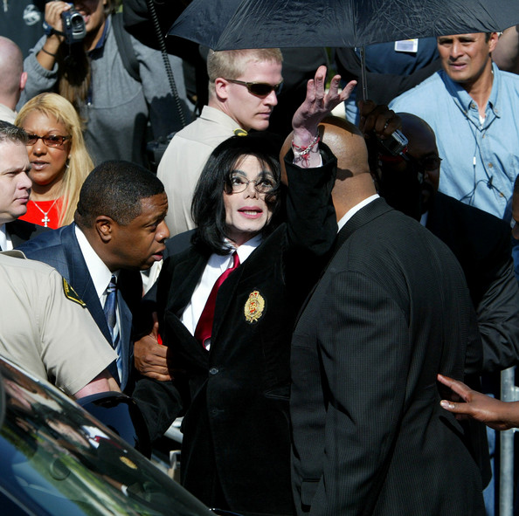
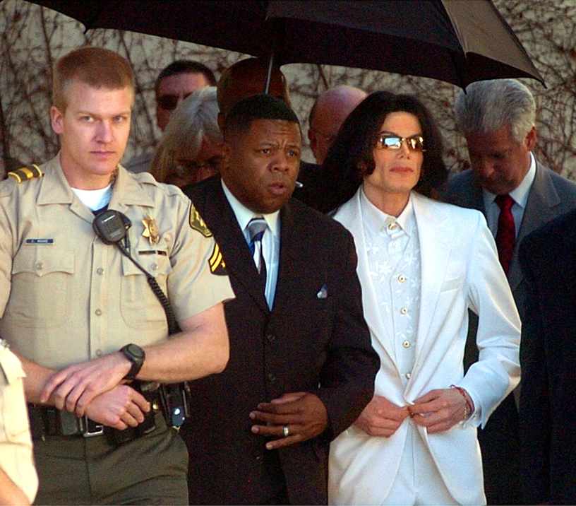
Notes:
This should be the style on all of you slide with content.

Slide 5
Simple Methods / Preventable Death
Similar to:
CPR
Heimlich
Stop, Drop, and Roll
Easy for all staff and older students to learn
Be cautious with your presentation

Slide 6
YouTube Shooting
Notes:
This should be the style on all of you slide with content.

Slide 7
Demonstration
Adult Tourniquet
Pediatric Tourniquet
Wound Packing
Assessment
Choking
Hands-Only CPR
Determine time needed to teach each skill
Manage group size
Adapt to total time allowed (build in breaks)
Keep training in nearby rooms

Slide 8
Example
Adult Tourniquet
Pediatric Tourniquet
Wound Packing
Assessment
Choking
Hands-Only CPR
Determine time needed to teach each skill: 20 minutes
Group size: 90 people
Adapt to total time allowed (build in breaks): 2 hours
Group sizes: 15 people in each
Number of instructors: 6-12
Notes:
Obtain instructors from hospitals, law enforcement, Fire department, EMS, etc.

Slide 9
Options
Reunifica-tion
Radio
Tabletop Scenario
Team Scenario
Pressure Points
Occlusive Dressing
Keep a theme
Random topics
All tabletop exercises
All test scenarios

Slide 10
Options
Tornado tabletop
Psycho-logical 1st Aid
Tourniquets
Wound packing
Hypothermia
Casualty exchange points
Keep a theme (tornadoes in this example)
Random topics
All tabletop exercises
All test scenarios

Slide 11
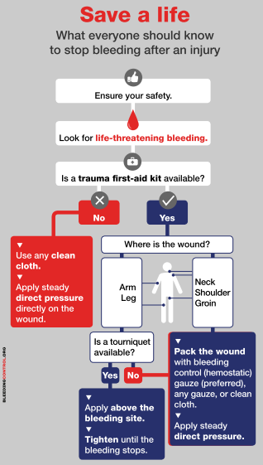
3 Minutes

Slide 12
Glen Moore, MSW
417-252-0571
moore@mosba.org
2100 I-70 Drive Southwest
Columbia, MO 65203
www.mosba.org
Twitter: @MissouriSBA | Facebook: @moschoolboards| #2020MSBA
Notes:
This is you contact slide. Add your information and leave up after your presentation so people can write down you contact information.

